Slide 1
ANOVA, Multiple comparisons & Type I Errors

Slide 2
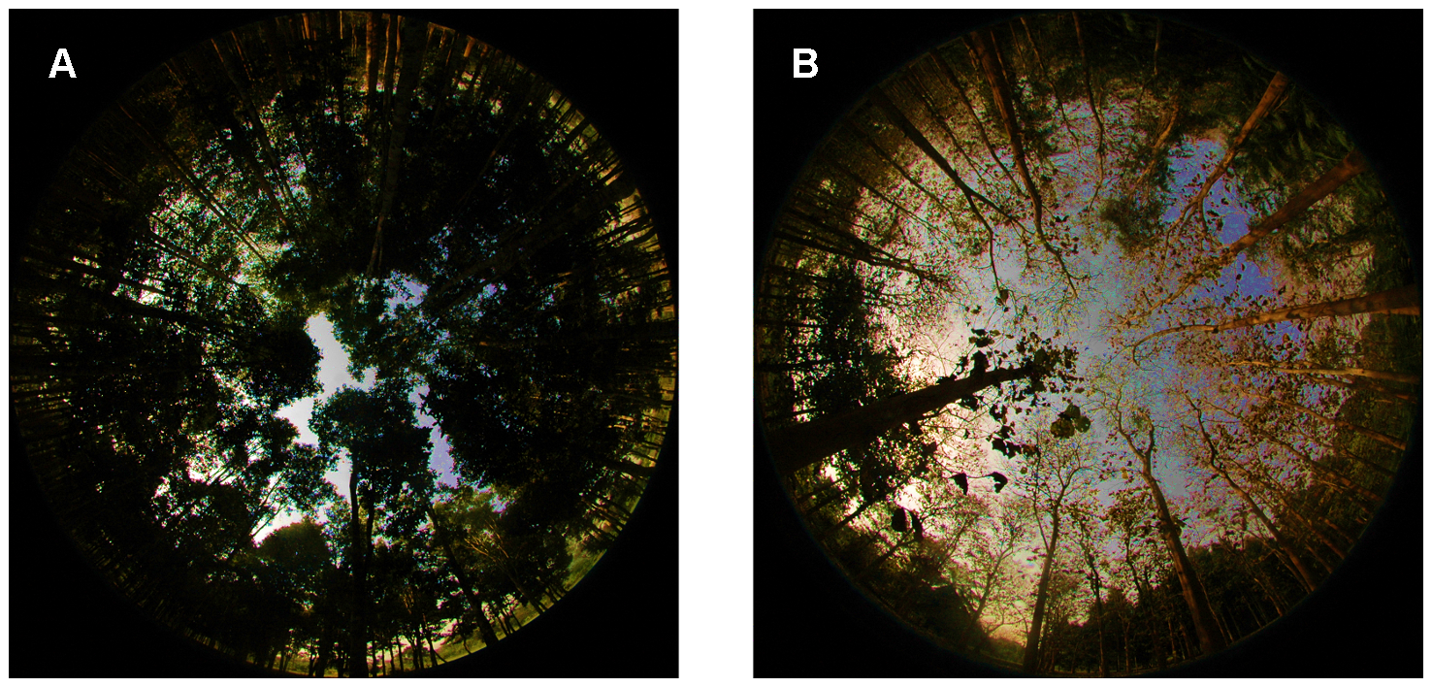

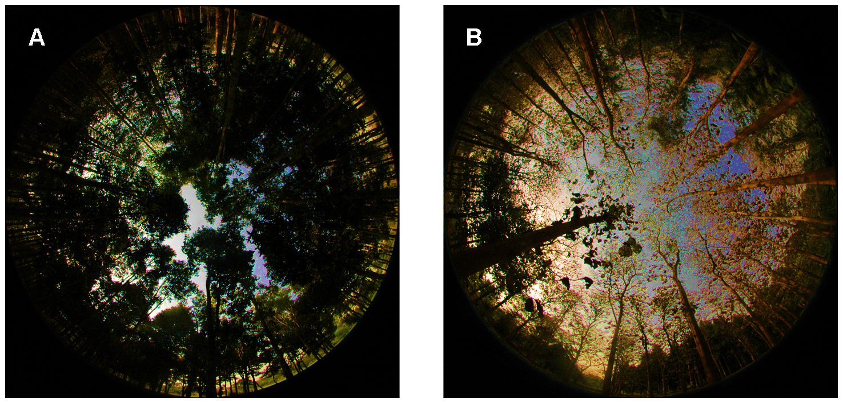
Fisheye photographs & canopy closure
(hemispheric photo)
Glathorn & Beckschäfer 2014 PLOS

Slide 3
Glathorn & Beckschäfer 2014 PLOS

Slide 4
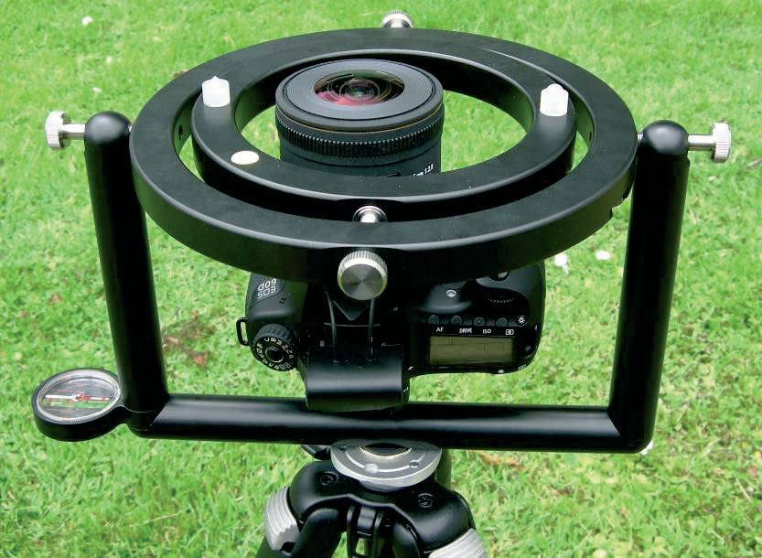
Fisheye photographs & canopy closure
(hemispheric photo)

Slide 5
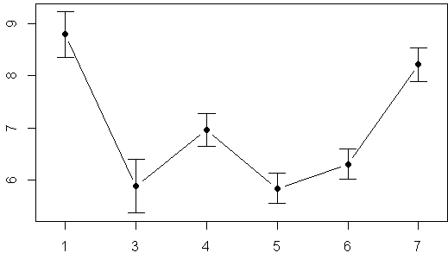
Canopy closure above 7 forest plots
More light
How open is canopy at each plot?
Less light
Error bars = 95%CI
Plot 1
Plot Number

Slide 6
Canopy closure above 7 forest plots
More light
Study original designed to monitor impacts of deer on forest
How open is canopy at each plot?
Less light
Error bars = 95%CI
Plot 1
Plot Number

Slide 7
Canopy closure above 7 forest plots
More light
Which plots are significantly different from each other?
How open is canopy at each plot?
Less light
Error bars = 95%CI
Plot 1
Plot Number

Slide 8
Canopy closure above 7 forest plots
More light
Compare all plots to plot 1
How open is canopy at each plot?
Less light
Error bars = 95%CI
Plot 1
Plot Number

Slide 9
Canopy closure above 7 forest plots
More light
Compare all plots to plot 4
How open is canopy at each plot?
Less light
Error bars = 95%CI
Plot 1
Plot Number

Slide 10
Canopy closure above 7 forest plots
More light
How open is canopy at each plot?
Less light
Error bars = 95%CI
Plot 1
Plot Number

Slide 11
Canopy closure above 7 forest plots
More light
How open is canopy at each plot?
Less light
Error bars = 95%CI
Plot 1
Plot Number

Slide 12
Canopy closure above 7 forest plots
More light
How open is canopy at each plot?
Less light
Error bars = 95%CI
Plot 1
Plot Number

Slide 13
Canopy closure above 7 forest plots
More light
How open is canopy at each plot?
Less light
Error bars = 95%CI
Plot 1
Plot Number

Slide 14
Overall steps in an ANOVA
1) Plot raw data with boxplots & histograms
2) Plot mean values w/ confidence intervals
3) Do omnibus F-test to determine if there are any significant differences
4) If p < 0.05 at least 1 pair of means are different (but which pair?)
5) Do pairwise comparisons using modified t-tests as needed
6) Correct for multiple comparisons as needed

Slide 15
Overall steps in an ANOVA
1) Plot raw data with boxplots & histograms
2) Plot mean values w/ confidence intervals
3) Do omnibus F-test to determine if there are any significant differences
4) If p < 0.05 at least 1 pair of means are different (but which pair?)
5) Do pairwise comparisons using modified t-tests as needed
6) Correct for multiple comparisons as needed

Slide 16
Overall steps in an ANOVA
1) Plot raw data with boxplots & histograms
2) Plot mean values w/ confidence intervals
3) Do omnibus F-test to determine if there are any significant differences
4) If p < 0.05 at least 1 pair of means are different (but which pair?)
5) Do pairwise comparisons using modified t-tests as needed
6) Correct for multiple comparisons as needed

Slide 17
Overall steps in an ANOVA
1) Plot raw data with boxplots & histograms
2) Plot mean values w/ confidence intervals
3) Do omnibus F-test to determine if there are any significant differences
4) If p < 0.05 at least 1 pair of means are different (but which pair?)
5) Do pairwise comparisons using modified t-tests as needed
6) Correct for multiple comparisons as needed

Slide 18
Overall steps in an ANOVA
1) Plot raw data with boxplots & histograms
2) Plot mean values w/ confidence intervals
3) Do omnibus F-test to determine if there are any significant differences
4) If p < 0.05 at least 1 pair of means are different (but which pair?)
5) Do pairwise comparisons using modified t-tests as needed
6) Correct for multiple comparisons as needed

Slide 19
Overall steps in an ANOVA
1) Plot raw data with boxplots & histograms
2) Plot mean values w/ confidence intervals
3) Do omnibus F-test to determine if there are any significant differences
4) If p < 0.05 at least 1 pair of means are different (but which pair?)
5) Do pairwise comparisons using modified t-tests as needed
6) Correct for multiple comparisons as needed

Slide 20
Overall steps in an ANOVA
This is how your book & many others do things
-This is how I’m doing things (and so should you)
-There is debate whether this step is really necessary
1) Plot raw data with boxplots & histograms
2) Plot mean values w/ confidence intervals
3) Do omnibus F-test to determine if there are any significant differences
4) If p < 0.05 at least 1 pair of means are different (but which pair?)
5) Do pairwise comparisons using modified t-tests as needed
6) Correct for multiple comparisons as needed

Slide 21

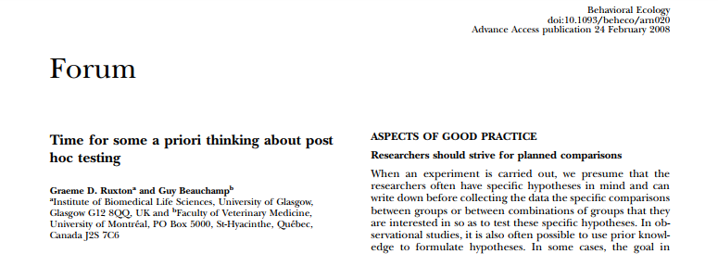

Slide 22
2 Types of pairwise comparisons
“Planned Comparisons”
“Un-planned comparisons”
These comparisons are/were:
planned before the study was conducted (eg, placebo vs. drug)
Those that determined how the study was designed
Usually much fewer in number than all possible comparisons
Often comparisons between a control (eg. Placebo) & several treatments (drug.1, drug.2, drug.3)
These are Usually used to test hypotheses the come up AFTER the data were collected and/or analyses began
Eg., both drug.2 & drug.3 decrease blood pressure. Is the effect of drug.2 > drug.3?
These can often be large in number
Often called “data dredging” or “fishing.”
Often result in after-the-fact explanations (“hand waving”)
Should best be considered as exploratory analyses that should be followed up by a new study

Slide 23
2 Types of pairwise comparisons
“Planned Comparisons”
“Un-planned comparisons”
These comparisons are/were:
planned before the study was conducted (eg, placebo vs. drug)
Those that determined how the study was designed
Usually much fewer in number than all possible comparisons
Often comparisons between a control (eg. Placebo) & several treatments (drug.1, drug.2, drug.3)
These are Usually used to test hypotheses the come up AFTER the data were collected and/or analyses began
Eg., both drug.2 & drug.3 decrease blood pressure. Is the effect of drug.2 > drug.3?
These can often be large in number
Often called “data dredging” or “fishing.”
Often result in after-the-fact explanations (“hand waving”)
Should best be considered as exploratory analyses that should be followed up by a new study

Slide 24
2 Types of pairwise comparisons
“Planned Comparisons”
“Un-planned comparisons”
These comparisons are/were:
planned before the study was conducted (eg, placebo vs. drug)
Those that determined how the study was designed
Usually much fewer in number than all possible comparisons
Often comparisons between a control (eg. Placebo) & several treatments (drug.1, drug.2, drug.3)
These are Usually used to test hypotheses the come up AFTER the data were collected and/or analyses began
Eg., both drug.2 & drug.3 decrease blood pressure. Is the effect of drug.2 > drug.3?
These can often be large in number
Often called “data dredging” or “fishing.”
Often result in after-the-fact explanations (“hand waving”)
Should best be considered as exploratory analyses that should be followed up by a new study

Slide 25
Types of pairwise comparisons
“Planned Comparisons”
“Un-planned comparisons”
These comparisons are/were:
planned before the study was conducted (eg, placebo vs. drug)
Those that determined how the study was designed
Usually much fewer in number than all possible comparisons
Often comparisons between a control (eg. Placebo) & several treatments (drug.1, drug.2, drug.3)
These are Usually used to test hypotheses the come up AFTER the data were collected and/or analyses began
Eg., both drug.2 & drug.3 decrease blood pressure. Is the effect of drug.2 > drug.3?
These can often be large in number
Often called “data dredging” or “fishing.”
Often result in after-the-fact explanations (“hand waving”)
Should best be considered as exploratory analyses that should be followed up by a new study

Slide 26
Types of pairwise comparisons
“Planned Comparisons”
“Un-planned comparisons”
These comparisons are/were:
planned before the study was conducted (eg, placebo vs. drug)
Those that determined how the study was designed
Usually much fewer in number than all possible comparisons
Often comparisons between a control (eg. Placebo) & several treatments (drug.1, drug.2, drug.3)
These are Usually used to test hypotheses the come up AFTER the data were collected and/or analyses began
Eg., both drug.2 & drug.3 decrease blood pressure. Is the effect of drug.2 > drug.3?
These can often be large in number
Often called “data dredging” or “fishing.”
Often result in after-the-fact explanations (“hand waving”)
Should best be considered as exploratory analyses that should be followed up by a new study

Slide 27
Types of pairwise comparisons
“Planned Comparisons”
“Un-planned comparisons”
These comparisons are/were:
planned before the study was conducted (eg, placebo vs. drug)
Those that determined how the study was designed
Usually much fewer in number than all possible comparisons
Often comparisons between a control (eg. Placebo) & several treatments (drug.1, drug.2, drug.3)
These are Usually used to test hypotheses the come up AFTER the data were collected and/or analyses began
Eg., both drug.2 & drug.3 decrease blood pressure. Is the effect of drug.2 > drug.3?
These can often be large in number
Often called “data dredging” or “fishing.”
Often result in after-the-fact explanations (“hand waving”)
Should best be considered as exploratory analyses that should be followed up by a new study

Slide 28
Types of pairwise comparisons
“Planned Comparisons”
“Un-planned comparisons”
These comparisons are/were:
planned before the study was conducted (eg, placebo vs. drug)
Those that determined how the study was designed
Usually much fewer in number than all possible comparisons
Often comparisons between a control (eg. Placebo) & several treatments (drug.1, drug.2, drug.3)
These are Usually used to test hypotheses the come up AFTER the data were collected and/or analyses began
Eg., both drug.2 & drug.3 decrease blood pressure. Is the effect of drug.2 > drug.3?
These can often be large in number
Often called “data dredging” or “fishing.”
Often result in after-the-fact explanations (“hand waving”)
Should best be considered as exploratory analyses that should be followed up by a new study

Slide 29
Types of pairwise comparisons
“Planned Comparisons”
“Un-planned comparisons”
These comparisons are/were:
planned before the study was conducted (eg, placebo vs. drug)
Those that determined how the study was designed
Usually much fewer in number than all possible comparisons
Often comparisons between a control (eg. Placebo) & several treatments (drug.1, drug.2, drug.3)
These are Usually used to test hypotheses the come up AFTER the data were collected and/or analyses began
Eg., both drug.2 & drug.3 decrease blood pressure. Is the effect of drug.2 > drug.3?
These can often be LARGE in number
Often called “data dredging” or “fishing.”
Often result in after-the-fact explanations (“hand waving”)
Should best be considered as exploratory analyses that should be followed up by a new study

Slide 30
Types of pairwise comparisons
“Planned Comparisons”
“Un-planned comparisons”
These comparisons are/were:
planned before the study was conducted (eg, placebo vs. drug)
Those that determined how the study was designed
Usually much fewer in number than all possible comparisons
Often comparisons between a control (eg. Placebo) & several treatments (drug.1, drug.2, drug.3)
These are Usually used to test hypotheses the come up AFTER the data were collected and/or analyses began
Eg., both drug.2 & drug.3 decrease blood pressure. Is the effect of drug.2 > drug.3?
These can often be LARGE in number
Often called “data dredging” or “fishing.”
Often result in after-the-fact explanations (“hand waving”)
Should best be considered as exploratory analyses that should be followed up by a new study

Slide 31
Types of pairwise comparisons
“Planned Comparisons”
“Un-planned comparisons”
These comparisons are/were:
planned before the study was conducted (eg, placebo vs. drug)
Those that determined how the study was designed
Usually much fewer in number than all possible comparisons
Often comparisons between a control (eg. Placebo) & several treatments (drug.1, drug.2, drug.3)
These are Usually used to test hypotheses the come up AFTER the data were collected and/or analyses began
Eg., both drug.2 & drug.3 decrease blood pressure. Is the effect of drug.2 > drug.3?
These can often be large in number
Often called “data dredging” or “fishing.”
Often result in after-the-fact explanations (“hand waving”)
Should best be considered as exploratory analyses that should be followed up by a new study

Slide 32
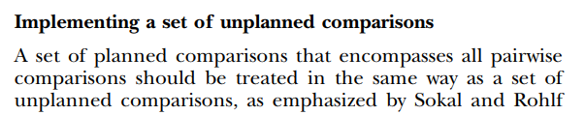
Note:
some ecologists assert that if you are doing more than 2 or 3 “planned” pairwise comparisons, you should still treat them as un-planned

Slide 33
Types of pairwise comparisons
“Planned Comparisons”
“Un-planned comparisons”
These comparisons are/were:
planned before the study was conducted (eg, placebo vs. drug)
Those that determined how the study was designed
Usually much fewer in number than all possible comparisons
Often comparisons between a control (eg. Placebo) & several treatments (drug.1, drug.2, drug.3)
These are Usually used to test hypotheses the come up AFTER the data were collected and/or analyses began
Eg., both drug.2 & drug.3 decrease blood pressure. Is the effect of drug.2 > drug.3?
These can often be large in number
Often called “data dredging” or “fishing.”
Often result in after-the-fact explanations (“hand waving”)
Should best be considered as exploratory analyses that should be followed up by a new study
New movement in Psychology & medical studies
“Pre-registration” of
studies/experiments, their design, the planned comparisons & statistical techniques
Why pre-register studies?

Slide 34
Types of pairwise comparisons
“Planned Comparisons”
“Un-planned comparisons”
These comparisons are/were:
planned before the study was conducted (eg, placebo vs. drug)
Those that determined how the study was designed
Usually much fewer in number than all possible comparisons
Often comparisons between a control (eg. Placebo) & several treatments (drug.1, drug.2, drug.3)
These are Usually used to test hypotheses the come up AFTER the data were collected and/or analyses began
Eg., both drug.2 & drug.3 decrease blood pressure. Is the effect of drug.2 > drug.3?
These can often be large in number
Often called “data dredging” or “fishing.”
Often result in after-the-fact explanations (“hand waving”)
Should best be considered as exploratory analyses that should be followed up by a new study
New movement in Psychology & medical studies
“Pre-registration” of
studies/experiments, their design, the planned comparisons & statistical techniques
Why pre-register studies?

Slide 35
Types of pairwise comparisons
“Planned Comparisons”
“Un-planned comparisons”
These comparisons are/were:
planned before the study was conducted (eg, placebo vs. drug)
Those that determined how the study was designed
Usually much fewer in number than all possible comparisons
Often comparisons between a control (eg. Placebo) & several treatments (drug.1, drug.2, drug.3)
These are Usually used to test hypotheses the come up AFTER the data were collected and/or analyses began
Eg., both drug.2 & drug.3 decrease blood pressure. Is the effect of drug.2 > drug.3?
These can often be large in number
Often called “data dredging” or “fishing.”
Often result in after-the-fact explanations (“hand waving”)
Should best be considered as exploratory analyses that should be followed up by a new study
New movement in Psychology & medical studies
“Pre-registration” of
studies/experiments, their design, the planned comparisons & statistical techniques
Why pre-register studies?

Slide 36
Types of pairwise comparisons
“Planned Comparisons”
“Un-planned comparisons”
These comparisons are/were:
planned before the study was conducted (eg, placebo vs. drug)
Those that determined how the study was designed
Usually much fewer in number than all possible comparisons
Often comparisons between a control (eg. Placebo) & several treatments (drug.1, drug.2, drug.3)
These are Usually used to test hypotheses the come up AFTER the data were collected and/or analyses began
Eg., both drug.2 & drug.3 decrease blood pressure. Is the effect of drug.2 > drug.3?
These can often be large in number
Often called “data dredging” or “fishing.”
Often result in after-the-fact explanations (“hand waving”)
Should best be considered as exploratory analyses that should be followed up by a new study
New movement in Psychology & medical studies
“Pre-registration” of
studies/experiments, their design, the planned comparisons & statistical techniques
Why pre-register studies?

Slide 37
Types of pairwise comparisons
“Planned Comparisons”
“Un-planned comparisons”
These comparisons are/were:
planned before the study was conducted (eg, placebo vs. drug)
Those that determined how the study was designed
Usually much fewer in number than all possible comparisons
Often comparisons between a control (eg. Placebo) & several treatments (drug.1, drug.2, drug.3)
These are Usually used to test hypotheses the come up AFTER the data were collected and/or analyses began
Eg., both drug.2 & drug.3 decrease blood pressure. Is the effect of drug.2 > drug.3?
These can often be large in number
Often called “data dredging” or “fishing.”
Often result in after-the-fact explanations (“hand waving”)
Should best be considered as exploratory analyses that should be followed up by a new study
New movement in Psychology & medical studies
“Pre-registration” of
studies/experiments, their design, the planned comparisons & statistical techniques
Why pre-register studies?

Slide 38
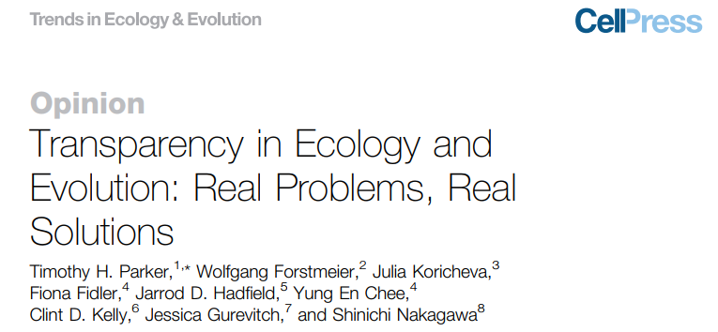
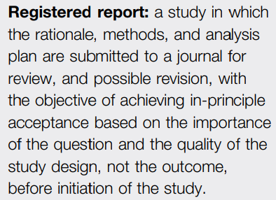
Preregistration & registered reports
in Ecology

Slide 39
Types of pairwise comparisons
“Planned Comparisons”
“Un-planned comparisons”
In practice, “un-planned” comparisons often result in apparently novel findings – yeah!
Fame & glory…
… and then the results can never be replicated by another lab.
These comparisons are/were:
planned before the study was conducted (eg, placebo vs. drug)
Those that determined how the study was designed
Usually much fewer in number than all possible comparisons
Often comparisons between a control (eg. Placebo) & several treatments (drug.1, drug.2, drug.3)
These are Usually used to test hypotheses the come up AFTER the data were collected and/or analyses began
Eg., both drug.2 & drug.3 decrease blood pressure. Is the effect of drug.2 > drug.3?
These can often be large in number
Often called “data dredging” or “fishing.”
Often result in after-the-fact explanations (“hand waving”)
Should best be considered as exploratory analyses that should be followed up by a new study

Slide 40


Slide 41
Types of pairwise comparisons
“Planned Comparisons”
“Un-planned comparisons”
In practice, “un-planned” comparisons often result in apparently novel findings – yeah!
Fame & glory…
… and then the results can never be replicated by another lab.
Why does the replication fail?
These comparisons are/were:
planned before the study was conducted (eg, placebo vs. drug)
Those that determined how the study was designed
Usually much fewer in number than all possible comparisons
Often comparisons between a control (eg. Placebo) & several treatments (drug.1, drug.2, drug.3)
These are Usually used to test hypotheses the come up AFTER the data were collected and/or analyses began
Eg., both drug.2 & drug.3 decrease blood pressure. Is the effect of drug.2 > drug.3?
These can often be large in number
Often called “data dredging” or “fishing.”
Often result in after-the-fact explanations (“hand waving”)
Should best be considered as exploratory analyses that should be followed up by a new study

Slide 42
Types of pairwise comparisons
“Planned Comparisons”
Conducting many comparisons increases the Probability of a Type I error
Rejecting the null hypothesis when it actually shouldn’t be rejected
“Rejecting a true null hypothesis”
“False positive"
In practice, “un-planned” comparisons often result in apparently novel findings – yeah!
Fame & glory…
… and then the results can never be replicated by another lab.
Why does the replication fail?
These comparisons are/were:
planned before the study was conducted (eg, placebo vs. drug)
Those that determined how the study was designed
Usually much fewer in number than all possible comparisons
Often comparisons between a control (eg. Placebo) & several treatments (drug.1, drug.2, drug.3)

Slide 43
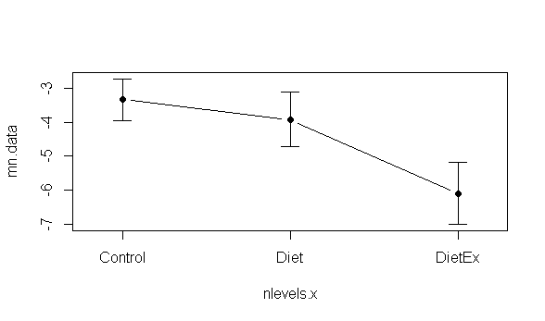
Effects of different diets on weight loss
Question:
Does either diet lead to weight loss?
Both diets were thought to be equally effect
Weight loss
(lbs)
Diet.1
Diet.2
Treatment

Slide 44

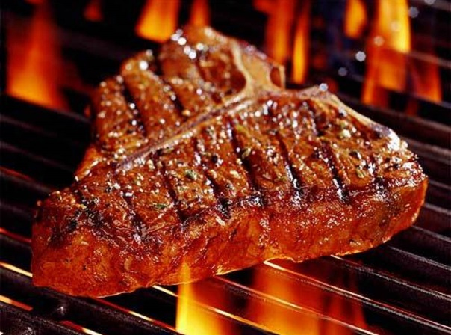
Effects of different diets on weight loss
Question:
Does either diet lead to weight loss?
Both diets were thought to be equally effect
Weight loss
(lbs)
Diet.1
Diet.2
Treatment

Slide 45
Effects of different diets on weight loss
Weight loss
(lbs)
Diet.1
Diet.2
Treatment

Slide 46
Effects of different diets on weight loss:
Planned Comparisons
Weight loss
(lbs)
Control vs Diet 1
Control vs. Diet 2
Diet.1
Diet.2
Treatment

Slide 47
Effects of different diets on weight loss:
Planned Comparisons
Weight loss
(lbs)
Control vs Diet 1
Control vs. Diet 2
Diet.1
Diet.2
Treatment

Slide 48
Effects of different diets on weight loss:
UN-Planned Comparisons
Weight loss
(lbs)
Diet 1vs Diet 2
Diet.1
Diet.2
Treatment

Slide 49
Effects of different diets on weight loss:
UN-Planned Comparisons
Weight loss
(lbs)
Diet 1vs Diet 2
Diet.1
Diet.2
Treatment

Slide 50
Planned Comparisons:
-Most ecologists won’t “correct” for this…but there is some debate…
-use t-test or “modified t-test” to compare pairs of means->modified t-test more powerful
-requires honesty about what comparisons were planned
-journal editors may require that you do re-do analysis & do corrections
Weight loss
(lbs)
Control vs Diet 1
Control vs. Diet 2
Diet.1
Diet.2
Treatment

Slide 51
UN-Planned Comparisons:
-Require that p-values be “corrected” so that Type-1 errors do not get “inflated”
-Many many many many many ways to do this
-This course/this book: Tukey Kramer / TukeyHSD method
Weight loss
(lbs)
Diet 1 vs. Diet 2
Diet.1
Diet.2

Slide 52
Type 1 Error:
Accidently rejecting a TRUE null hypothesis
(thinking Ha is true even though it isn’t; “false positive”)
Say we get data like this:
Weight loss
(lbs)
Diet 1 vs. Diet 2
Diet.1
Diet.2

Slide 53
Type 1 Error:
Accidently rejecting a TRUE null hypothesis
But in reality, due to human metabolism, Diet.2 really doesn’t actually have an effect.
People on Diet.2 just happened to lose weight during the study.
(just bad luck for the researchers)
Weight loss
(lbs)
Diet 1 vs. Diet 2
Diet.1
Diet.2

Slide 54
Type 1 Error:
Accidently rejecting a TRUE null hypothesis
But in reality, due to human metabolism, Diet.2 really doesn’t have an effect.
People on Diet.2 just happened to lose weight during the study.
Difference between reality and experiment just due to random events un-related to the study (maybe they all had stressful semesters or new teaching loads…)
Weight loss
(lbs)
Diet.1
Diet.2

Slide 55
Type 1 Error:
Accidently rejecting a TRUE null hypothesis
The more comparisons you make, the more likely you are to commit a Type I error
When you go fishing with “un-planned” comparisons you are likely to have this
happen
Weight loss
(lbs)
Diet 1 vs. Diet 2
Diet.1
Diet.2

Slide 56
Type 1 Error (page 160)
“Type 1 error is rejecting a true null hypothesis. The significance level alpha (α) [the threshold where we say something is “statistically significance”] sets the probability of committing a Type 1 Error.
“if the null hypothesis were true, we would reject it mistakenly one time in 20” (pg 160)
This is sometimes called a “false positive.” We falsely conclude that there is a difference when there isn’t.

Slide 57
Type 2 Error (page 160)
“Type 2 error is failing to reject a false null hypothesis”
“If a null hypothesis is false, we need to reject it to get the right answer. Failure to reject a false null hypothesis is a Type 2 error.”
This is sometimes called a “false negative.” We falsely conclude that there is not a difference when there actually is.
“A study that has a low probability of Type 2 error is said to have high power.”

